Slide 1
Cyclistic Project
By: Savannah Rodriguez

Slide 2

Cyclistic Background
Cyclistic is a bike-share company in Chicago that provides more than 5,800 bikes and 600 docking stations. This encompasses a variety of bike types including accessible friendly bikes. Bike trips are available for casual riders with single ride or day passes and a membership service for frequent riders.

Slide 3
Business Task
What:
The director of marketing believes the company’s future success depends on maximizing the number of annual memberships. To achieve this growth Cyclistic has chosen it is best to convert casual riders into members rather than targeting outside customers.
How:
To properly market and transition casual riders to membership riders we must answer, how do annual members and casual riders use Cyclistic bikes differently. These insights will lead a path on how to best market and influence casual riders to make membership commitments through digital marketing.

Slide 4
Prepare & Process
We are using prescreened and approved dataset offered by Google which uses publicly available data from the City of Chicago’s bike sharing service Divvy in operations with Lyft. This data set is available for usage under the terms of agreements specified and is organized in spreadsheets.
In order to maintain consistency and simplicity within the dataset blank rows and duplicates were cleared. Next values were minimized and columns that measure the duration of bike trips and the day of the week each trip began were added. Lastly, to avoid test trips or false starts, all trips below 2 minutes were removed.

Slide 5

Analysis Results
Membership Rider Insights
Based on past analysis we know Cyclistic users are more likely to ride for leisure, but about 30% use them to commute to work each day. Based on a combination of trends it is safe to assume that those 30% align with member riders.
The first trend that suggests this is that member rides are found to ride the most on Monday’s with an average ride length of 13 minutes.

Slide 6
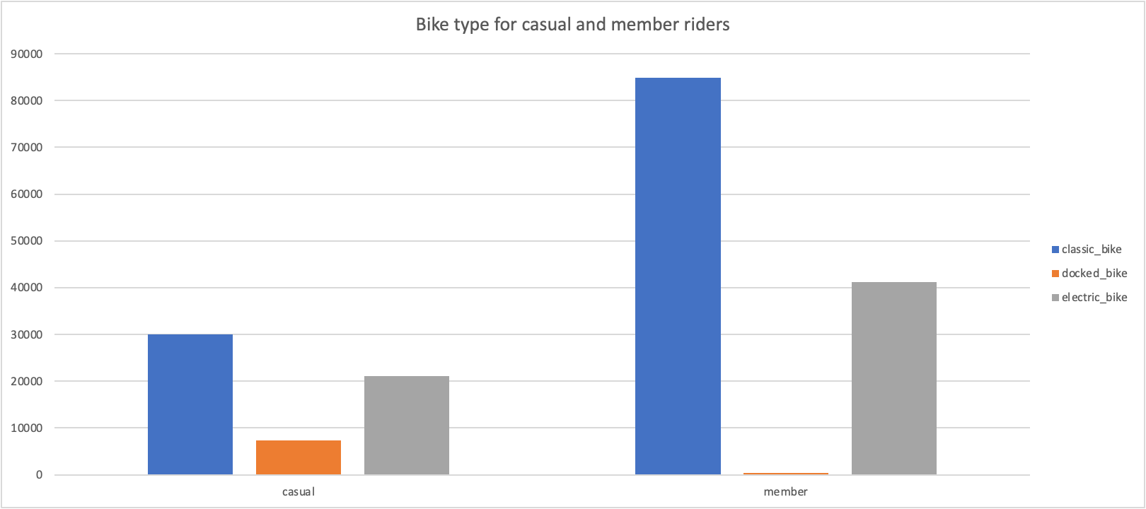
2) Based on past analysis we also know that the majority of riders opt for traditional bikes. This matches new analysis on bike preference for membership riders.
Membership riders prefer classic bikes more than electric or docked bikes.

Slide 7
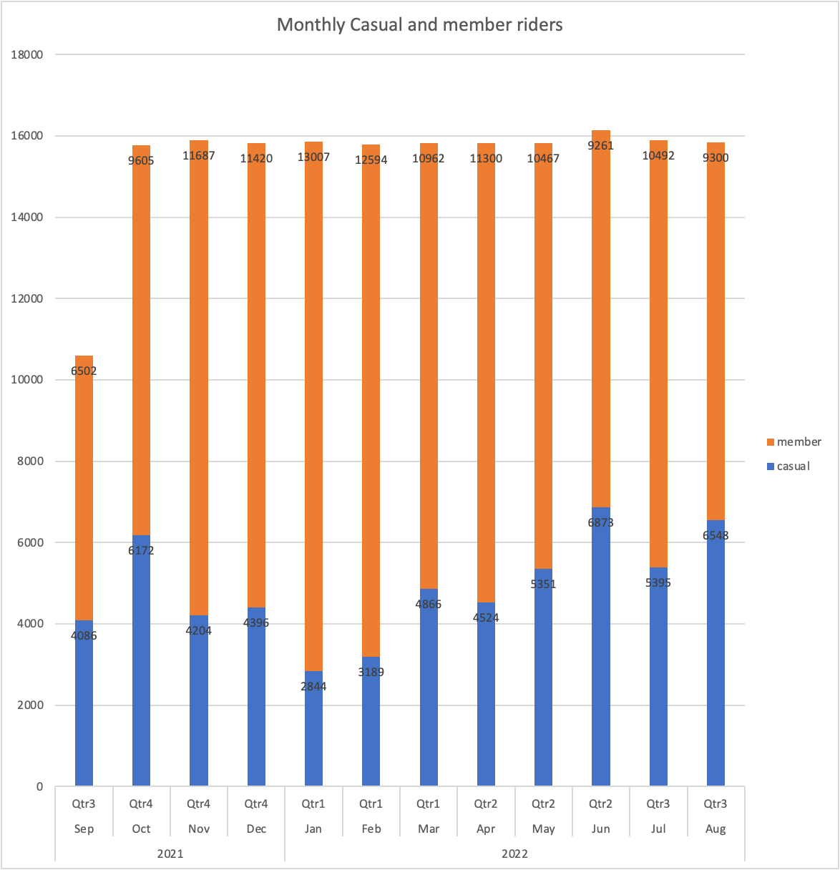
3) Membership experienced the most customers in the month of January and experienced the most growth from October through January.
This trend suggests again that more membership riders fall in the category as commuter riders. High ridership in fall & winter months suggest that their reasoning for riding may not be leisure.

Slide 8
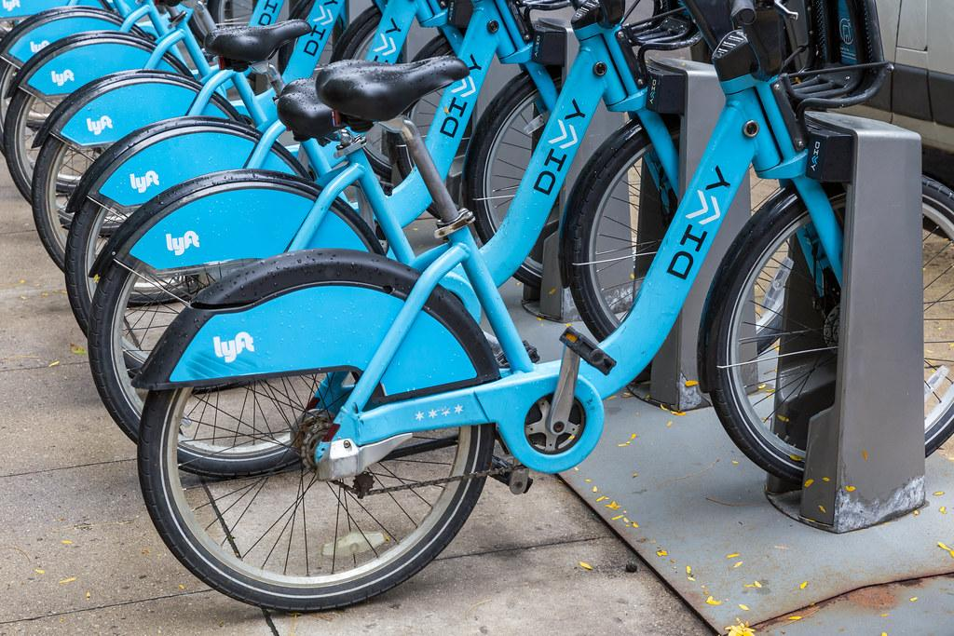
Casual Rider Insights
On average casual riders’ trips last the most on Sunday and average ride length last around 24 minutes. This supports the behavior of a customer who rides for leisure.
From previous analysis we know that 8% of riders prefer assistive options. Casual riders use docked bikes more than membership riders. Due to the specialty that comes with assistive bikes it is likely that they are required to be docked. With this assumption, casual riders might hold a majority of the assistive bike usage.

Slide 9
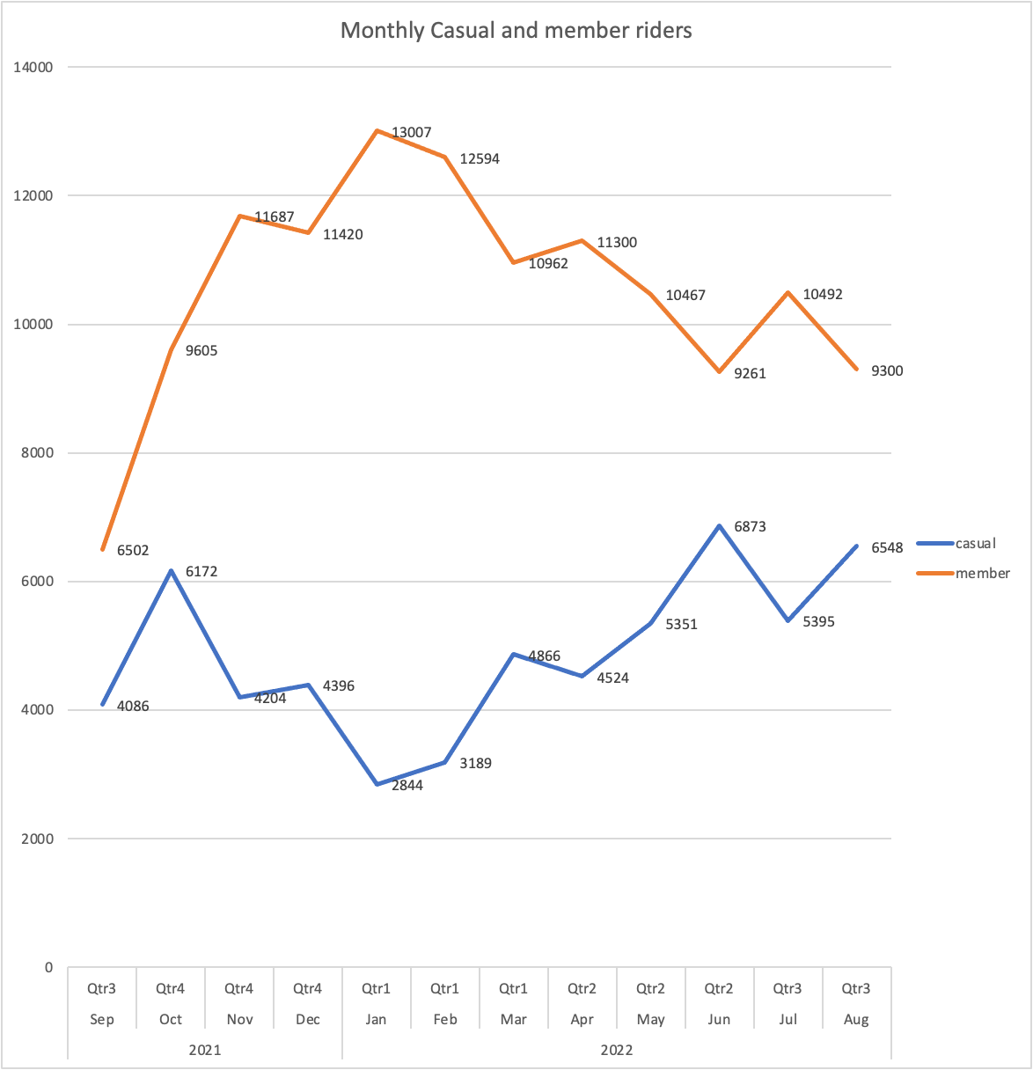
3) Casual ridership experienced the most customers in June and experienced the most growth in months February through June. With high ridership in spring & summer months, this aligns that casual customers ride for leisure.
4) Lastly, we can assume that casual customers and membership customers correlated. When casual riders experience their most customers member ridership declines to its lowest and vice versa.

Slide 10

Recommendations
Cyclistic has a 32% gap from having all customers become members. Given that casual and member riders are correlated the first suggestion is to focus on membership customer retention. By providing members more benefits and increasing customer relationships, member loyalty should be more established.
Based on membership trips averaging shorter durations and having more commuters, it might suggest that they use multiple modes of transportation. To cater to Cyclistic members, providing more docking stations closer to transportation hubs and working districts will increase convenience and customer satisfaction.

Slide 11

2) We know that membership declines the most during the spring and summer while casual ridership increases. The second recommendation is that Cyclistic increases digital marketing during these quarters. Increasing marketing will not only reach new audiences but will also provide a friendly reminder to current members that Cyclistic membership is the best option for customers.
There could be a variety of reasons why certain members cancel or switch to casual ridership during these quarters. Based on membership behavior we can categorize them as working people. Most working people take vacations and leaves during the summer which may indicate a loss in necessity. To combat this issue, creating a summer marketing campaign that highlights the benefits of Cyclistic membership might work well on preventing cancellations.
The following image is an example of a campaign from UCI.

Slide 12

3) The last recommendation is concluding what tools may be the best to promote the Cyclistic campaign. To best reach our target audience of members including ads on more professional aligned sites such as Linkedin or even community aligned platform like Facebook might be best. To go a step further Cyclistic can offer special packages to workplaces around the city where they host their employees to an event or even provide bikes for a team building event. Further acknowledging the membership customer base.
To best reach casual riders it might be useful to place ads on media platforms that promote active and social lifestyles such as Tiktok, Instagram, YouTube or even travel sites like Expedia and more.

Slide 13

Questions…

